Slide 1
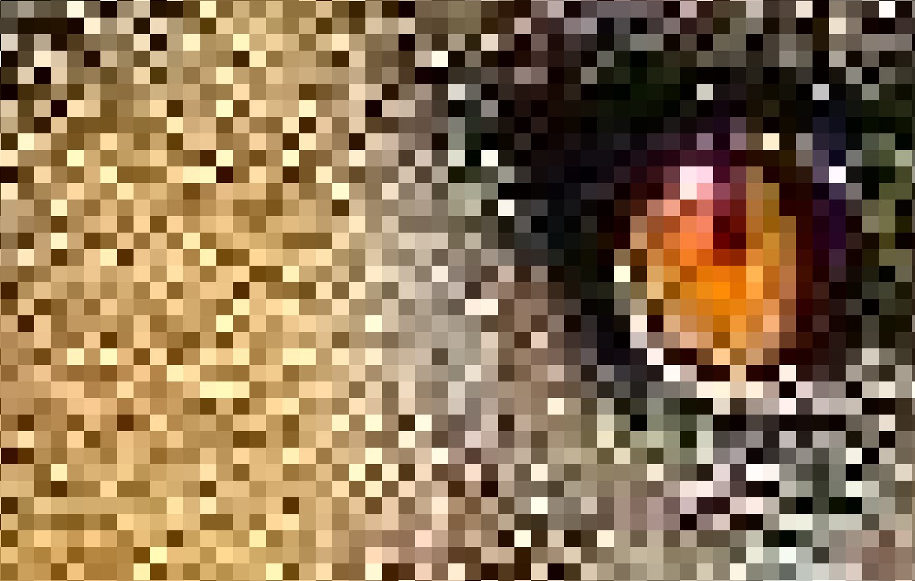
steganography
By Mark Torrens
Reviewed By: James Taylor
https://github.com/torrens/kainosSteg

Slide 2
Steganography
Overview
Uses in the wild
How to do it
Implementation strategy
Have a go

Slide 3
Steganography
Steganography means hiding data.
Not the same as cryptography, but cryptography is often involved.
Data can be hidden in images, videos, network protocols and anything else that’s digital.
We will be talking about steganography in images.

Slide 4
Uses in the wild
Data exfiltration and transport
Hiding malware payloads
Hiding botnet commands
Difficult to detect
Trends in steganography, 2014, https://arxiv.org/pdf/1202.5289.pdf
Exploring steganography: Seeing the unseen, 1998, http://www.creangel.com/papers/steganografia.pdf

Slide 5
Data Theft
Email an image to a friend
Upload a picture to social media
Store it on a USB drive and don’t worry about being caught
Upload to a cloud drive

Slide 6
Malware Distribution
In 2017, Proofpoint reported that malware called Zero.T used steganography to distribute further malware.
Zero.T is thought to be produced by a Chinese state sponsored actor.
VirusTotal reports it was first scanned 11th January 2017.
https://www.proofpoint.com/us/threat-insight/post/APT-targets-russia-belarus-zerot-plugx

Slide 7
Malware Configuration
In 2015, Pierre-Marc Bureau, Christian Dietrich presented at BlackHat conference how Gozi Neverquest malware uses steganography to extract the url from a favicon file to download its main configuration file from.
Gozi Neverquest is malware designed to steal data from financial institutions.
32 x 32 = 1024 x 3(RGB) = 3072 bits = 384 bytes – plenty of space for a url
https://www.blackhat.com/docs/eu-15/materials/eu-15-Bureau-Hiding-In-Plain-Sight-Advances-In-Malware-Covert-Communication-Channels-wp.pdf

Slide 8
Detection - Steganalysis
A great deal of research
Difference between research and an IDS that can detect Steganography
“All steganography detection programs today are essentially proof-of-concept, and their logic cannot be implemented in commercial security tools because they are slow, have fairly low detection rates …” August 3, 2017, SecureList.com
https://securelist.com/steganography-in-contemporary-cyberattacks/79276/

Slide 9
Legal Stuff
Using Steganography to steal data or distribute malware is an offence under the Computer Misuse Act (1990)
Getting caught may result in the end of your IT career and a custodial sentence.
Do no harm!
HMP Manchester (Strangeways) Watchtower

Slide 10
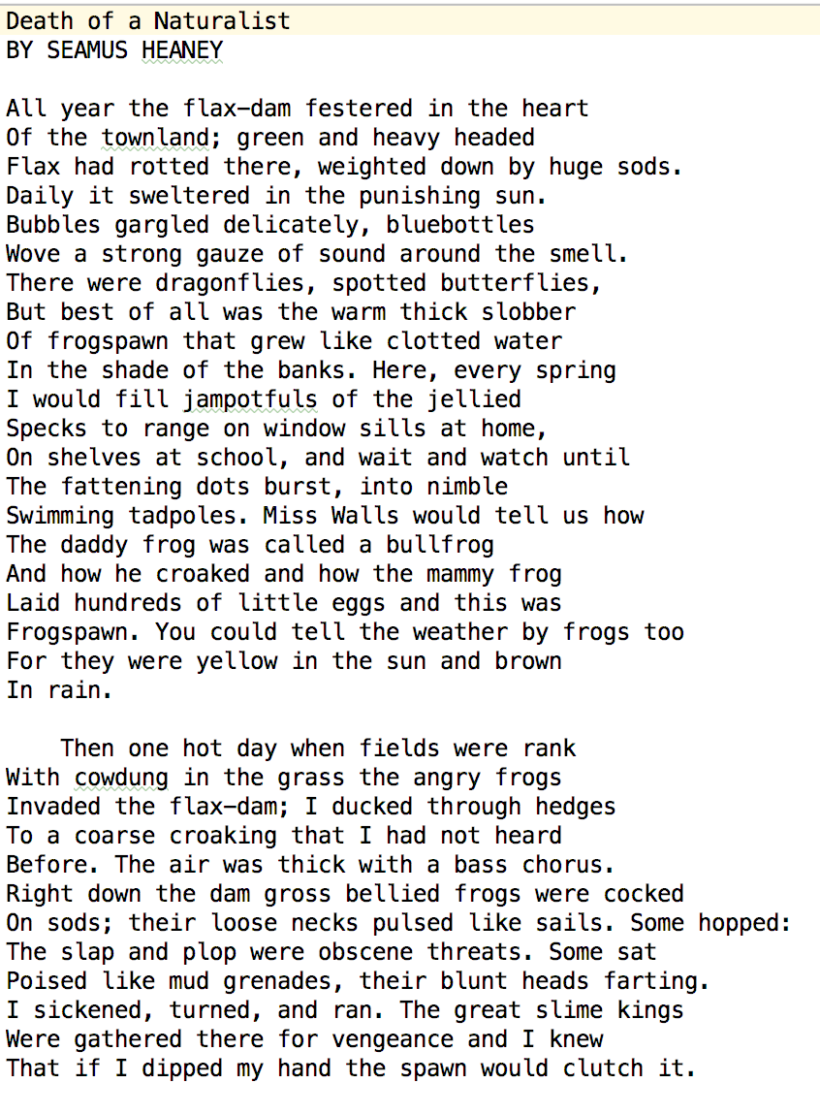
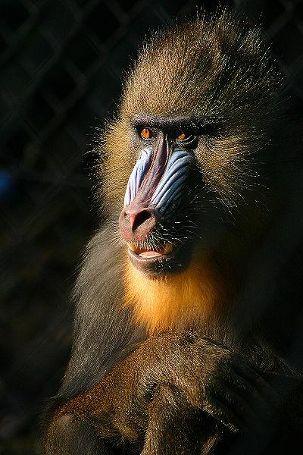
Steganography in images
Data to hide
Cover Image
Stego Image

Slide 11
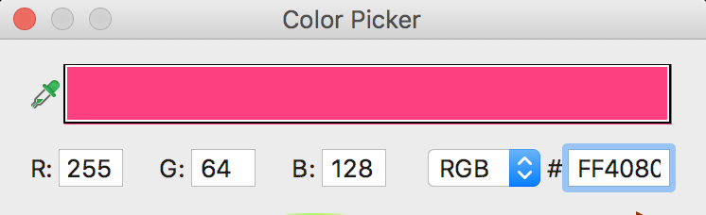
Pixels made of red, green & blue colour values
Each R, G, B part is a byte ranging from 0 - 255

Slide 12
Reminder about how a byte is made
Bit 8 | Bit 7 | Bit 6 | Bit 5 | Bit 4 | Bit 3 | Bit 2 | Bit 1
128 | 64 | 32 | 16 | 8 | 4 | 2 | 1
0 | 1 | 0 | 0 | 0 | 0 | 0 | 1
These 8 bits (a byte) represent 65 ASCII A
LSB – Bit 1

Slide 13
Altering the 4 Least Significant Bits
RGB( 255, 0, 0 )
RGB( 240, 0, 0 )
RGB( 0, 255, 0 )
RGB( 0, 240, 0 )
RGB( 0, 0, 255 )
RGB( 0, 0, 240 )
Bit 8 | Bit 7 | Bit 6 | Bit 5 | Bit 4 | Bit 3 | Bit 2 | Bit 1
128 | 64 | 32 | 16 | 8 | 4 | 2 | 1
1 | 1 | 1 | 1 | 0 | 0 | 0 | 0

Slide 14
Hiding one picture in another
Cover Image – 1 pixel
RED | GREEN | BLUE
11111111 | 11111111 | 11111111
Stego Image – 1 pixel
RED | GREEN | BLUE
1111 0000 | 1111 0000 | 1111 0000
Secret Image – 1 pixel
RED | GREEN | BLUE
00000000 | 00000000 | 00000000

Slide 15
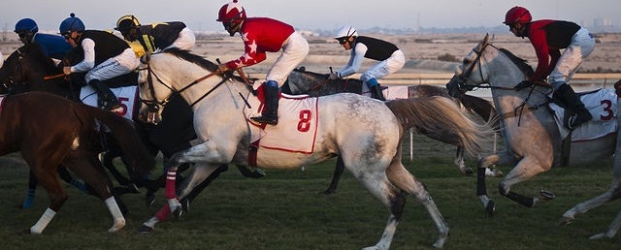
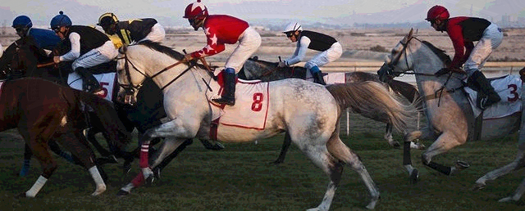
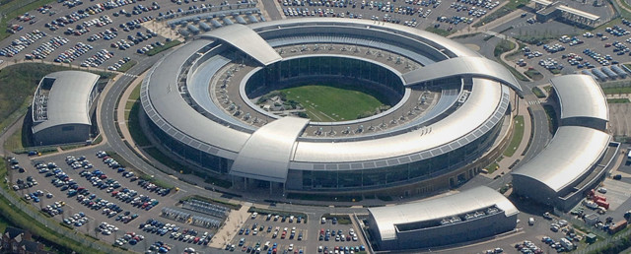
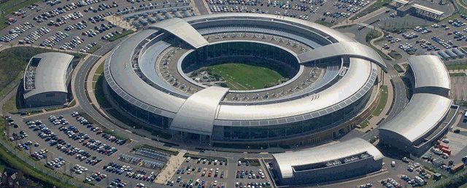
Hiding one picture in another
Cover Image
Stego Image
Secret Image
Retrieved Image

Slide 16
DEMO

Slide 17
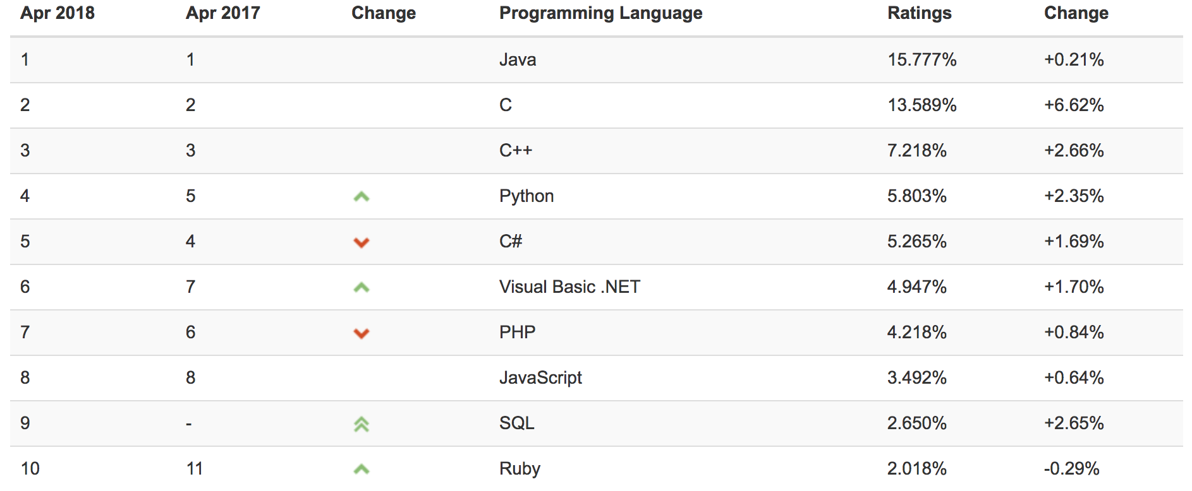
Python
https://www.tiobe.com/tiobe-index/

Slide 18
Hiding one byte in 8 pixels
A
0 1 0 0 0 0 0 1
RED | GREEN | BLUE
11111111 | 00000000 | 11111111
11111111 | 00000000 | 11111111
11111111 | 00000000 | 11111111
11111111 | 00000000 | 11111111
11111111 | 00000000 | 11111111
11111111 | 00000000 | 11111111
11111111 | 00000000 | 11111111
11111111 | 00000000 | 11111111
RED | GREEN | BLUE
11111111 | 0000000 1 | 11111111
11111111 | 0000000 0 | 11111111
11111111 | 0000000 0 | 11111111
11111111 | 0000000 0 | 11111111
11111111 | 0000000 0 | 11111111
11111111 | 0000000 0 | 11111111
11111111 | 0000000 1 | 11111111
11111111 | 0000000 0 | 11111111

Slide 19
Implementation Pseudocode
Create the Stego Image
Read the secret file.
Read the cover image.
Write the size of the secret file to the cover image.
Using LSB, write the secret file to the cover image.
Write the stego image.
Extract the secret file
Read the stego file
Read the secret file header.
Read the LSBs.
Write the secret file.

Slide 20
Utility functions provided
def get_pixel_coordinates(index, cols) - Given an index, return the x, y coordinates of an image
def set_lsb(byte, bit) – Set the LSB of a byte
def set_bit(byte, value, position) – Set a bit position of a byte
def get_bit_from_byte(byte, position) – Get a bit value from a byte
def get_bit_from_byte_array(secret_data, position) – Get a bit from a byte array

Slide 21
Challenge 1
Clone sample code from https://github.com/torrens/kainosSteg
Install python3 - brew install python
Install python image library - pip3 install Pillow
Prove that your environment can execute image_run.sh to see image hiding work.
Try and understand how the code is working

Slide 22
Challenge 2
Hide the poem Death of a Naturalist, by Seamus Heaney (1,494 bytes) in the image mandril.png using file_steg.py as a base.
You only need to get the combine method working.
Comments should guide you.
A solution is in file challenge2/file_steg_solution.py

Slide 23
Challenge 3
How much of the book Frankenstein, by Mary Shelley (450,755 bytes) can you hide in cover image?
Technique 1 - Use compression.
Technique 2 – Use more parts of the pixel.
Does the stego image look suspect?

Slide 24
Over to you!

